Slide 1


B.Tech Computer Science and Engineering – Vth Semester
Theory of Computation
Department of Computer Science and Engineering

Slide 2
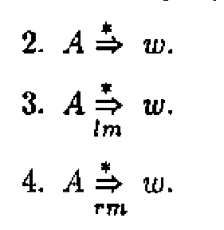
Inference Derivations and parse trees
For any grammar G=(V,T,P,S)
All the above derivations means ‘A’ a variable derives the string of terminals ‘w’ in 0 or more number is derivation steps.
All these derivations has individual trees with root A and yield w.

Slide 3
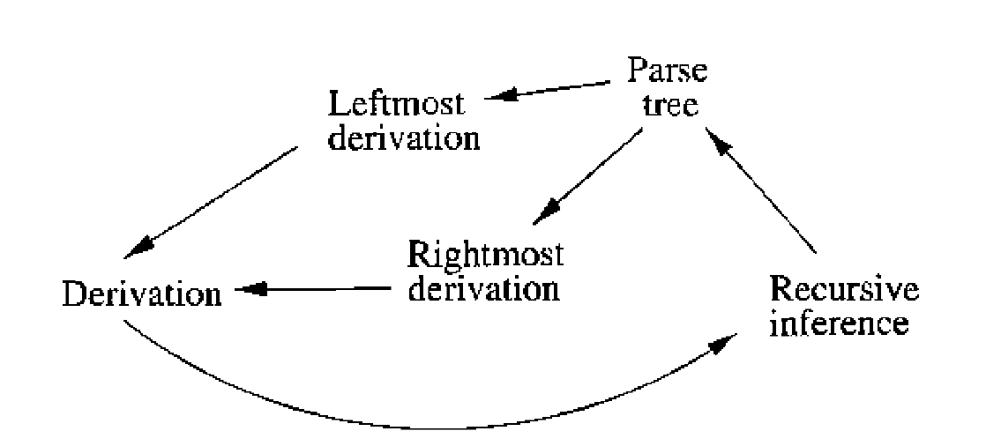
Some equivalencies in CFG, Trees and Derivation

Slide 4
From Inference to Trees Let G=(V,T,P,S) be a CFG if the recursive inference procedure tells us a string of terminals ‘w’ is in the language of A, then there is a parse tree with root A and yield ‘w’.
Proof: The proof is an induction on the number of steps used to infer that ‘w’ is in the language of A.
Basic : one step A yields w in one step. Then there must be a production A->w. In special case w can be ε too. Any way A->w is legal.

Slide 5
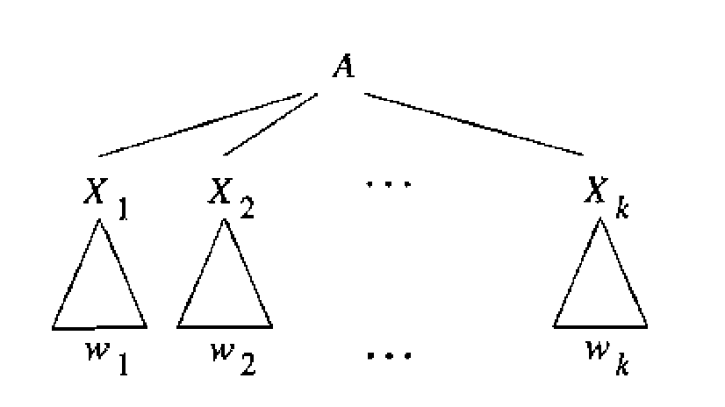
Induction:
‘w’ is inferred after n+1 steps and the statement of the theorem holds for all strings ‘x’ and variables ‘B’ such tha ‘x’ is derived from B was inferred using n are or fewer number of steps.

Slide 6
Proof ..
here X_{i} may be a variable or a terminal.
If X_{i} is a terminal then w_{i} =X_{i} then w_{i} consists of only from the production.
If X_{i} is a variable w_{i} is a string that was previously inferred to be from the language of X_{i}.
Thus the inference about w_{i} took at most n steps and not n+1 steps because the final step A->X_{i} X₂ X₃ ….X_{k} is surely not part of the inference of ‘w’.
By extending the inductive steps we can prove the tree has root A and yield as w₁ w₂ …w_{k} which is w.

Slide 7
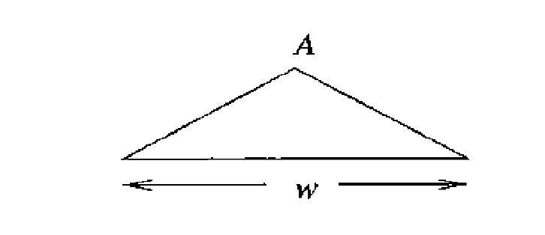
From Trees to Derivations Theorem: Let G=(V,T,P,S) and if there is a parse tree with root labelled by variable A and with yield ‘w’ where ‘w’ is in T*. Then there is a left most derivation A->*w in grammar G.
Proof: We perform an induction on the height of the tree.
Basis :the height of 1 i.e with a parse three with yield of ‘w’ and the tree will look like
This shows there is a production of form A->w

Slide 8
Proof..
If the height of the tree is ‘n’ where n>1, then there is a root A , with children X₁ X₂ …X_{k} the X may be either terminal or variable.
If X_{i} is a terminal, we define w_{i} to be the string consisting of X_{i} alone.
If X_{i} is a variable, then it must be the root of some subtree with a yield of terminals, which we shall call w_{i.} note here the subtree is of height less than ‘n’ so the inductive hypothesis applies to it. i.e the left most derivation X_{i}->w_{i} exists.

Slide 9
Let us see this derivations sample
A-> X₁ X₂ …X_{k} for i=1,2,..k
A->w₁ w₂... w_{i-1} X_{i} X_{i+1} …X_{k}
A->w₁ w₂... w_{i} X_{i+1} X_{i+2} …X_{k}
i.e if the derivation for X_{i} is X_{i} ->α₁-> α₂->…->w_{i}
then we continue like
A->w₁ w₂... w_{i-1} X_{i} X_{i+1} …X_{k}
A->w₁ w₂... w_{i-1} α₁ X_{i+1} …X_{k}
A->w₁ w₂... w_{i-1} α₂ X_{i+1} …X_{k}
A->w₁ w₂... w_{i} X_{i+1} X_{i+2} …X_{k}
By extending this assumption we can conclude the derivation
A->w₁ w_{2..} w_{k}

Slide 10
Thank You

Slide 11
Similarly
Theorem: Theorem: Let G=(V,T,P,S) and if there is a parse tree with root labelled by variable A and with yield ‘w’ where ‘w’ is in T*. Then there is a Right Most D erivation A->*w in grammar G.

